Slide 1

Step 3
Register for Classes
PCC Dual Credit | dualcredit@pcc.edu | 971-722-7737

Slide 2

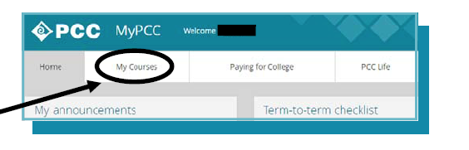
Make sure to have the 5-digit CRN (course reference number) for the class in which you want to register.
Registration dates are available on our website at https://www.pcc.edu/prepare/head-start/dual-credit/calendar.html
Step 1:
Go to https: my.pcc.edu/ and enter your PCC username and password.
Step 2:
Once logged in, click on the “My Courses” tab, located in the upper left of the screen.
PCC Dual Credit | dualcredit@pcc.edu | 971-722-7737

Slide 3
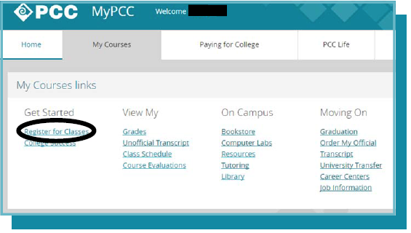
Step 3:
Click on “Register for Classes” link, located under the Get Started header.
PCC Dual Credit | dualcredit@pcc.edu | 971-722-7737

Slide 4
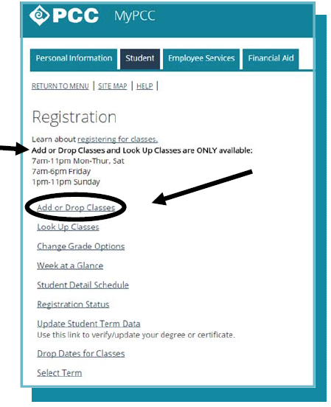
Note:
You may only add or drop classes during these specified hours.
Step 4:
Click on the “Add or Drop Classes” link
PCC Dual Credit | dualcredit@pcc.edu | 971-722-7737

Slide 5
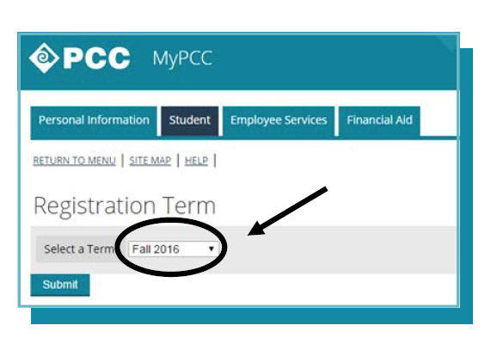
Step 5:
Select the appropriate PCC term from the drop-down box. Click on “Submit”.
This registration term is the effective start of the admission. Do not select a term that is out further than the term in which you want to register for.
For example:
If you select Spring as the registration term, then you may not be able to register for a Winter CRN.
Hint:
Yearlong, 2nd Semester, or 3rd Trimester classes – select Spring
1st Semester or 2nd Trimester classes – select Winter
1st Trimester classes – select Fall
PCC Dual Credit | dualcredit@pcc.edu | 971-722-7737

Slide 6
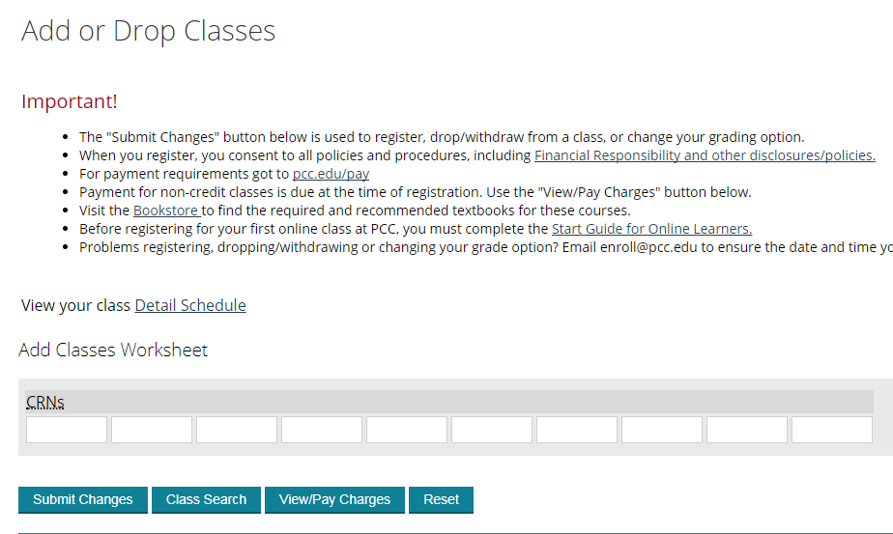
Step 6:
Enter the 5-digit CRN number into the first white box. Click on “Submit”.
You may register for multiple CRNs at one time by entering one CRN number per white box.
PCC Dual Credit | dualcredit@pcc.edu | 971-722-7737

Slide 7
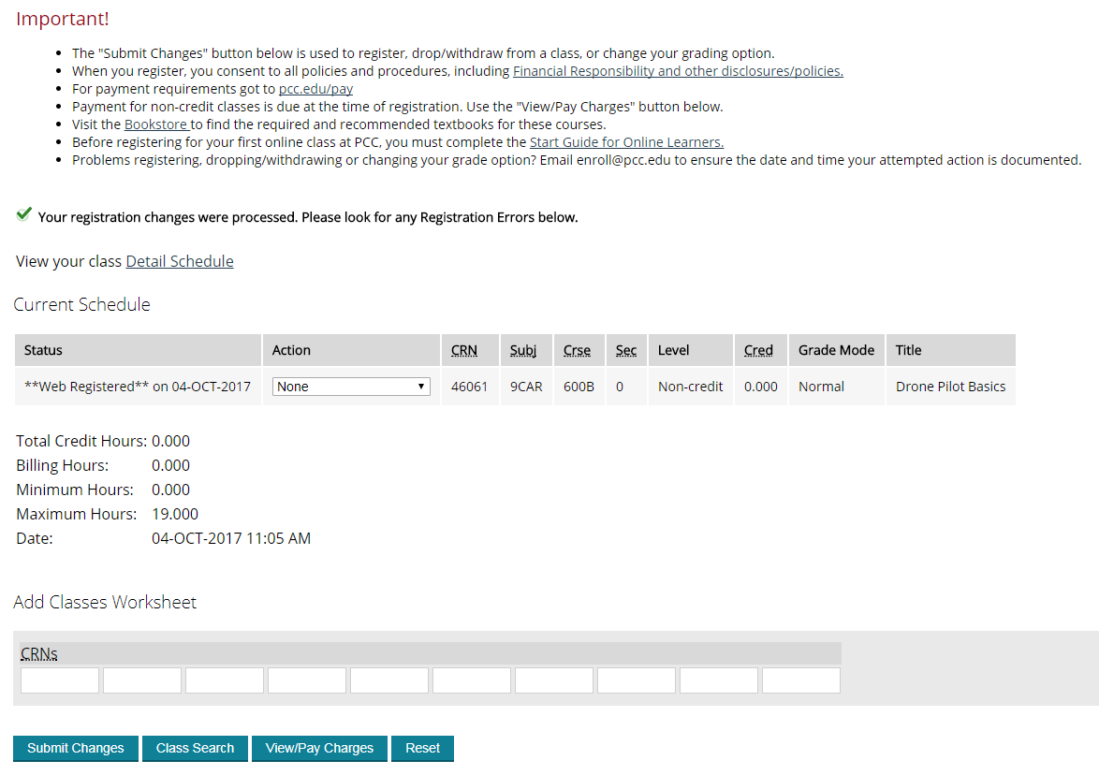
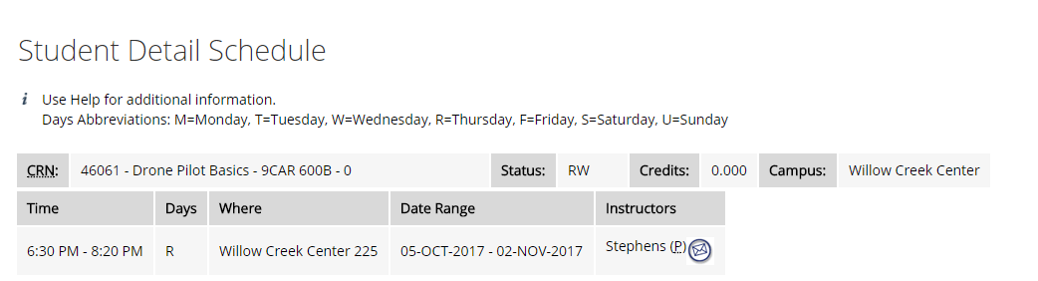
Step 7:
Verify that your registration went through (screen will look like this example).
Verify that the PCC subject & course is accurate.
Click on the “Detail Schedule” link and verify the instructors name.
A successful registration looks like this
PCC Dual Credit | dualcredit@pcc.edu | 971-722-7737

