Slide 1

Step 2
MyPCC Account Setup
PCC Dual Credit | dualcredit@pcc.edu | 971-722-7737

Slide 2

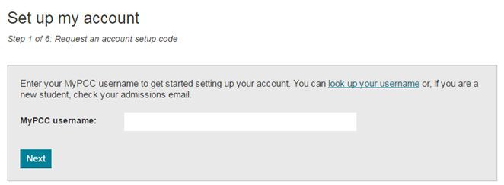
Set up account: Enter your username
pcc.edu/setup
PCC Dual Credit | dualcredit@pcc.edu | 971-722-7737

Slide 3

Set up account: Set up code message sent
PCC Dual Credit | dualcredit@pcc.edu | 971-722-7737

Slide 4
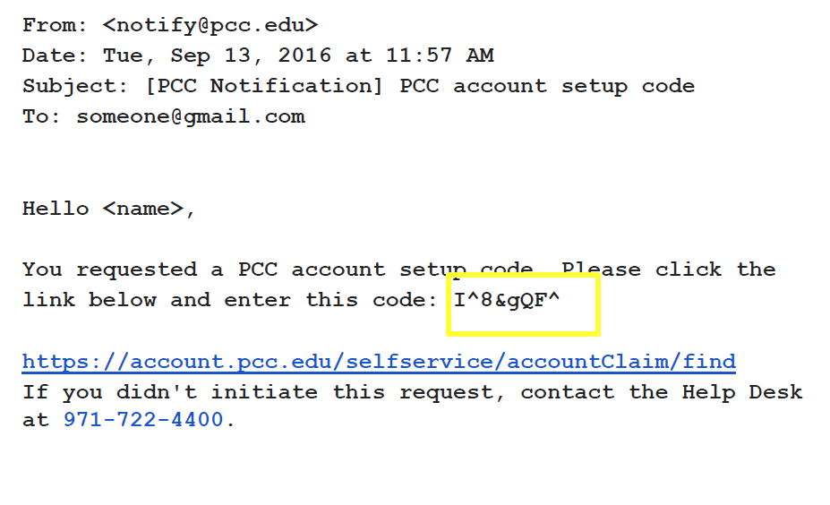
Set up account: Click link & copy code
PCC Dual Credit | dualcredit@pcc.edu | 971-722-7737

Slide 5
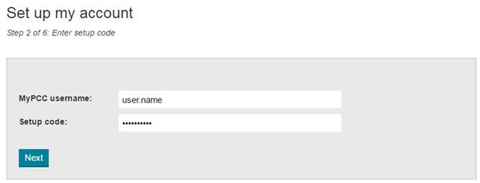
Set up account: Enter username & code
PCC Dual Credit | dualcredit@pcc.edu | 971-722-7737

Slide 6
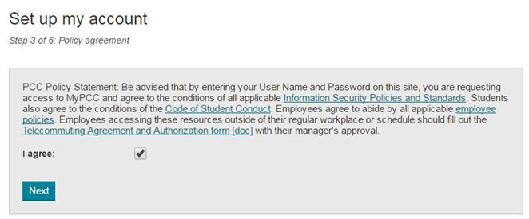
Set up account: Accept T & C
PCC Dual Credit | dualcredit@pcc.edu | 971-722-7737

Slide 7
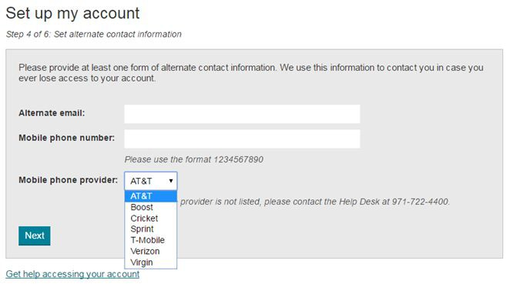
Set up account: Enter contact info
PCC Dual Credit | dualcredit@pcc.edu | 971-722-7737

Slide 8
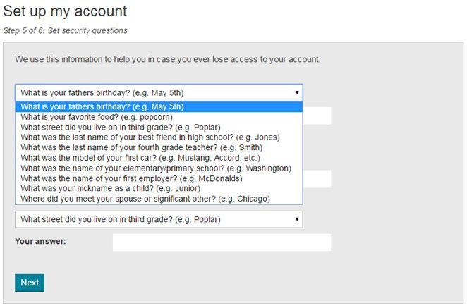
Set up account: Secret questions
PCC Dual Credit | dualcredit@pcc.edu | 971-722-7737

Slide 9
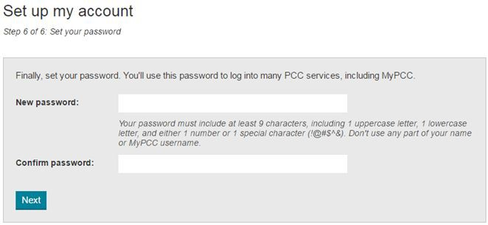
Set up account: Set up password
PCC Dual Credit | dualcredit@pcc.edu | 971-722-7737

Slide 10
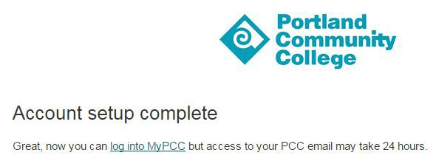
Set up account: DONE!
PCC Dual Credit | dualcredit@pcc.edu | 971-722-7737

