Slide 1
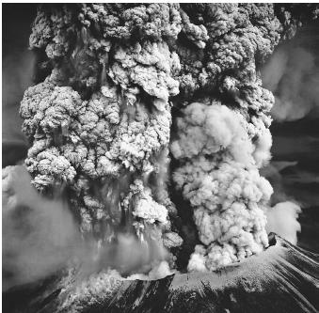
Where were you May 18th , 1980?
DAC Meeting 5/08/19

Slide 2

Degrees and Certificates Committee Meeting
May 8th 2019
SY CC 233B
DAC Meeting 5/08/19

Slide 4
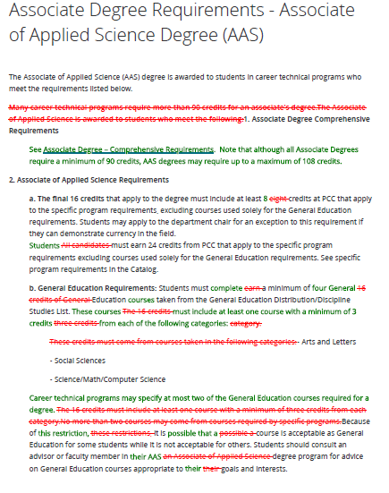
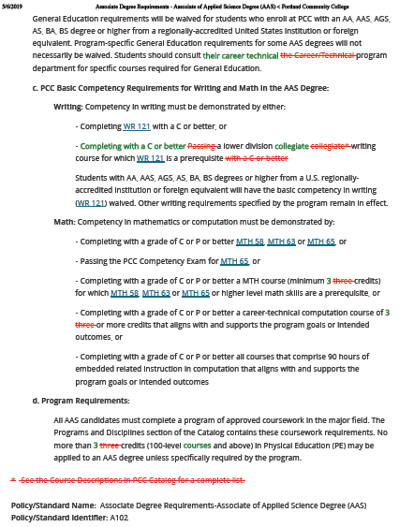
DAC Meeting 5/08/19

Slide 5
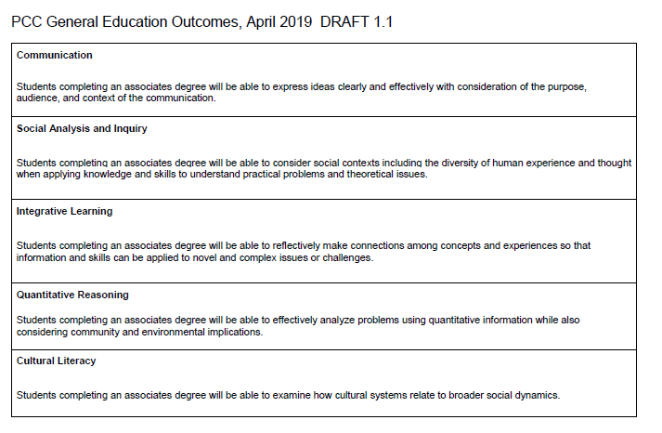
PCC Degree Outcomes: https://www.pcc.edu/resources/academic/degreeoutcome/
DAC Meeting 5/08/19

Slide 6
GER/GP Updates ….
ELIWG
https://spaces.pcc.edu/display/GEMAP
GEARS
https://spaces.pcc.edu/display/GEMAP/GEARS+-+General+Education+Assessment+Review+Subcommittee
Guided Pathways Team
https://spaces.pcc.edu/display/PGPT
DAC Meeting 3/13/19

Slide 7
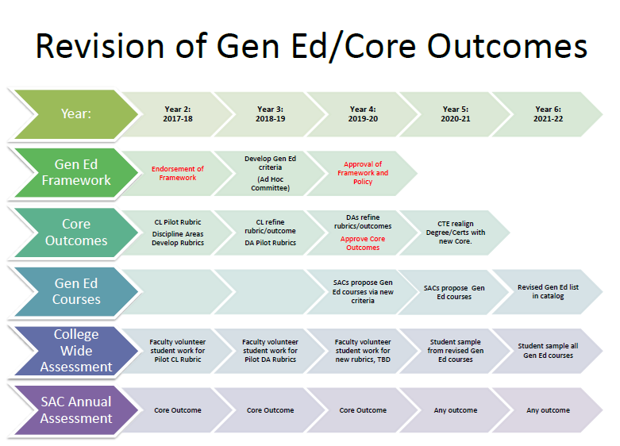
DAC Meeting 5/08/19

Slide 8
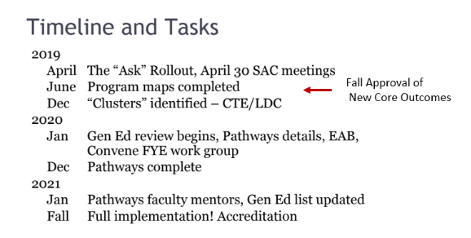
DAC Meeting 5/08/19

Slide 9
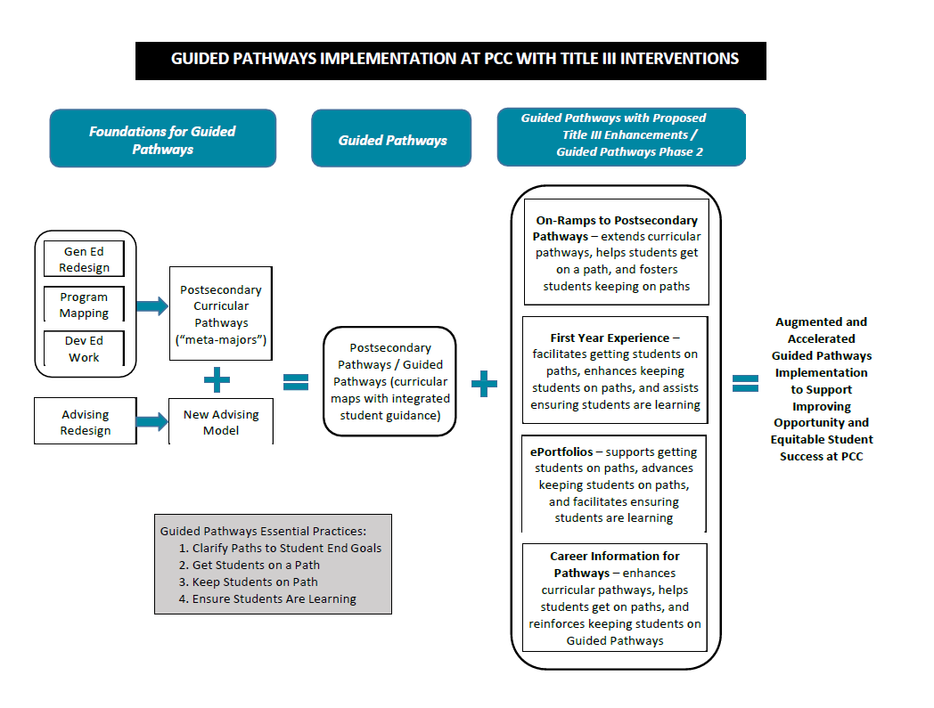
Title III
DAC Meeting 5/08/19

Slide 10
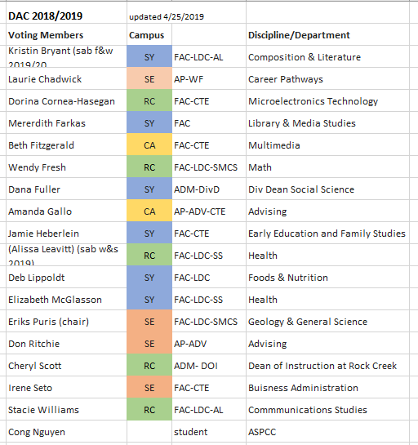
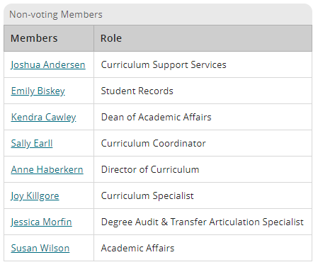
DACC Meeting 5/08/19

Slide 11
Degree issues related to Gen Ed Reform
Are the new Core Outcomes sufficient for degree outcomes?
Should all PCC degrees have a Cultural Literacy Outcome?
Should all PCC degree require a C or better?
DAC Meeting 5/08/19

Slide 12
DAC Meetings 2019/2020
Meeting Date | Notes
9/23/2019 | Retreat, Monday afternoon of inservice week
10/9/2019
11/13/2019
12/9/2019 | Monday!
1/15/2019
2/12/2019
3/11/2019
4/8/2019
5/13/2019
6/8/2019 | Monday!
??? | Additional ‘retreat’ for equity training?
DAC Meeting 5/08/19

Slide 14
DAC Meeting 5/08/19

