Slide 1

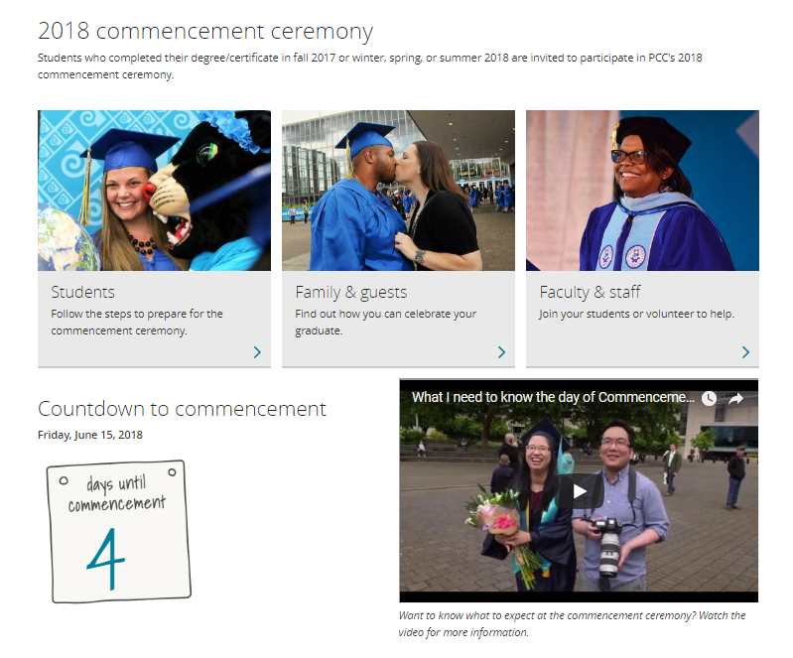
Source: https://www.pcc.edu/resources/graduation/commencement/
DACC Meeting 6/11/18

Slide 3
Informational Items
GE requirements for CTE
Proposed Gen Ed Framework Update
2018/2019 Meeting Schedule
DACC Meeting 6/11/18

Slide 5
Informational Items
Degree | Gen Ed/ Disc Stud
AGS | 16 credits | at least 3 credits from each category
AS | 21 credits | at least 7 credits from each category
AAOT | 11 courses (min 3 credits) | A&L + SS at least 3 credits from at least two disciplines SMCS at least 4 courses at least two discipline at least 3 lab courses CL at least one designated course from Disc Studies List
ASOT-B | 11 courses (min 3 credits) | &L + SS at least 3 credits from at least two disciplines SMCS at least 4 courses at least two discipline at least 3 lab courses CL at least one designated course from Disc Studies List
AAS | 16 credits | At least one course from each category, program can specify up to two
DACC Meeting 6/11/18

Slide 7
Framework for Gen Ed/Core Outcomes
Align Gen Ed and Core Outcomes
Link to Assessment via an Assignment
Assess Gen Ed/Core outcomes
College wide
SACs assess outcomes of their choice

Slide 8
Revision of Gen Ed/Core Outcomes
Gen Ed Framework
Endorsement of Framework
Develop Gen Ed criteria
(Ad Hoc Committee)
College Wide Assessment
Faculty volunteer student work for Pilot CL Rubric
Faculty volunteer student work for Pilot DA Rubrics
Year 2: 2017-18
Year 3: 2018-19
Year 4: 2019-20
Year 5: 2020-21
Year 6: 2021-22
SAC Annual Assessment
Gen Ed Courses
Core Outcome
SACs propose Gen Ed courses
Revised Gen Ed list in catalog
Core Outcome
Faculty volunteer student work for new rubrics, TBD
Core Outcome
Any outcome
Year:
Any outcome
SACs propose Gen Ed courses via new criteria
Approval of Framework and Policy
Core Outcomes
CL Pilot Rubric
Discipline Areas Develop Rubrics
CL refine rubric/outcome
DA Pilot Rubrics
DAs refine rubrics/outcomes
Approve Core Outcomes
CTE realign Degree/Certs with new Core.
Student sample all Gen Ed courses
Student sample from revised Gen Ed courses

Slide 9
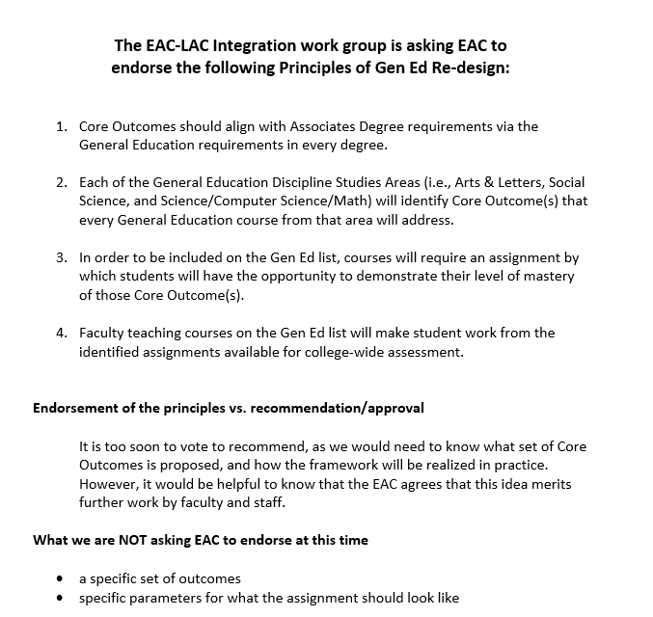

Slide 10
Revised Core Outcomes Institutional Student Learning Outcomes
Other ?
Integrative Learning (A&L)
S/CS/M
TBD
Critical Thinking (SS)
Cultural Literacy

Slide 11
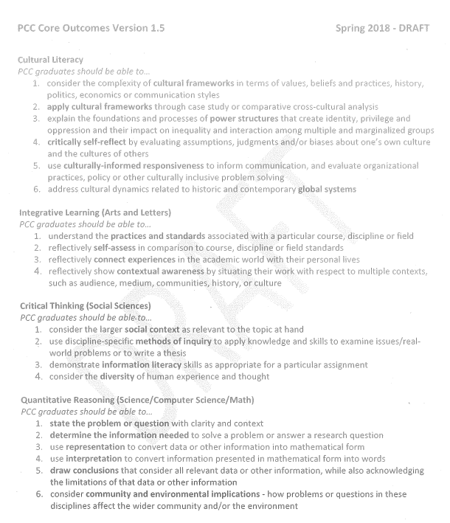

Slide 13
2018/2019 Meeting Schedule
Oct 10 W
Nov 14 W
Dec 10 Monday
Jan 16 W
Feb 13 W
March 13 W
April 10 W
May 8 W SE or SY?
June 5 W
DACC Meeting 6/11/18

